Slide 1


CAPITAL BUDGETING

Slide 2
INTRODUCTION
It can be defined as the process by which a business determines which fixed assets purchases or project investment are acceptable and which are not.
Examples:
Building a new plant
Taking a large scale in an outside venture.

Slide 3
PROCESS OF CAPITAL BUDGETING
IDENTIFYING AND GENERATING PROJECTS
EVALUVATING THE PROJECT
SELECTING A PROJECT
IMPLEMANTATION
PERFORMANCE REVIEW

Slide 4
TECHNIQUES OF CAPITAL BUDGETING
DISCOUNTING CASH FLOW
NON-DISCOUNTING CASH FLOW
It refers to a valuation method that estimates the value of an investment using its expected future cash flow.
A non-discount method of capital budgeting is one that does not consider the time value of money. In other words, all dollars earned in the future are assumed to have the same value as today's dollars.

Slide 5

DISCOUNTING CASH FLOW
NET PRESENT VALUE
NPV is the most popular and widely used discounted cash flow technique. It calculates the present value of future cash flows and compares them to the initial investment. If the NPV is positive, it indicates that the investment is expected to generate positive returns and create value for the company.
$$\text{NPV}=\left[\frac{C_{1}}{(1+k)}+\frac{C_{2}}{(1+k)^{2}}+\frac{C_{3}}{(1+k)^{3}}+ ⋯ +\frac{C_{n}}{(1+k)^{n}}\right]−C_{0} \\ \text{NPV}=\sum_{t=1}^{n}{ \frac{C_{t}}{(1+k)^{t}}−C_{0}}$$
C1, C2... | represent net cash inflows
k | opportunity cost of capital
C0 | initial cost of the investment
n | expected life of the investment

Slide 6
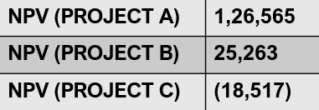
NUMERICAL EXAMPLE:
CASH OUTFLOW | A 7,50,000 | PRESENT VALUE | B 10,00,000 | PRESENT VALUE | C 5,00,000 | PRESENT VALUE
CASH INFLOW |  | CI*PV |  | CI*PV |  | CI*PV
1 | 4,00,000 | 3,60,360 | 1,50,000 | 1,35,135 | 80,000 | 72,072
2 | 1,50,000 | 1,21,740 | 1,80,000 | 1,46,088 | 80,000 | 64,928
3 | 2,75,000 | 2,01,025 | 2,20,000 | 1,60,820 | 1,90,000 | 1,38,928
4 | 1,00,000 | 65,870 | 1,95,000 | 1,94,110 | 1,00,000 | 65,870
5 | 1,50,000 | 89,025 | 3,50,000 | 2,07,550 | 1,50,000 | 89,025
6 | 75,000 | 38,545 | 3,40,000 | 1,81,560 | 1,00,000 | 50,660
TOTAL | 11,50,000 | 8,76,565 | 15,35,000 | 10,25,263 | 7,00,000 | 4,81,483

Slide 7
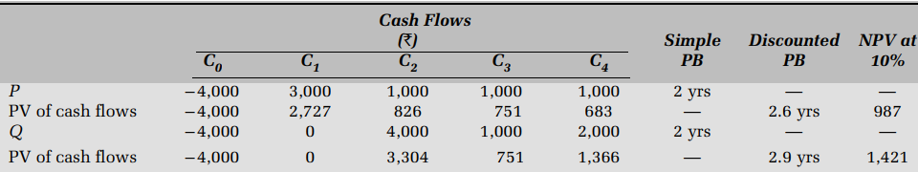
DISCOUNTING CASH FLOW
DISCOUNTED PAY-BACK PERIOD
The discounted payback period is the number of periods taken in recovering the investment outlay on the present value basis. The discounted payback period still fails to consider the cash flows occurring after the payback period.
Cash outflow

Slide 8

DISCOUNTING CASH FLOW
INTERNAL RATE OF RETURN
The internal rate of return (IRR) method is another discounted cash flow technique, which takes account of the magnitude and timing of cash flows.
R - | rate of return
Cо - | investment
Cı - | single cash flow after one period
LIMITATIONS:
It don’t cover non-conventional flows or multiple flows
Re-investment date couldn’t be recorded

Slide 9
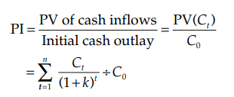
DISCOUNTING CASH FLOW
PROFITABILITY INDEX
Profitability index is the ratio of the present value of cash inflows, at the required rate of return, to the initial cash outflow of the investment.
PV - | Present value
Co- | Cash outflow
T- | Time
K- | Cost of capital

Slide 10


NON-DISCOUNTING CASH FLOW
PAY BACK PERIOD
Payback is the number of years required to recover the original cash outlay invested in a project. If the project generates constant annual cash inflows, the payback period can be computed by dividing cash outlay by the annual cash inflow.
For Example:

Slide 11
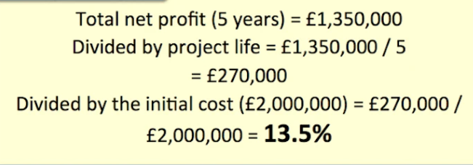

NON-DISCOUNTING CASH FLOW
ACCOUNTING RATE OF RETURN
The accounting rate of return, also known as the return on investment, uses accounting information, as revealed by financial statements, to measure the profitability of an investment.

Slide 12
CONCLUSION
The capital Budgeting process generally helps the company in taking two types of decisions:
Investment decisions
financing decisions
When there is no proper planning regarding the development of the project, there is always the risk of the sudden cost increase, delay in the development of the project, regulatory complications, etc. Thus, every company should have the proper capital budgeting processes taken place well in advance before initiating any large investment capital project. Apart from the above risks, the capital budgeting processes helps to evaluate the growth and profitability of the projects. This can also help to compare the profitability of different projects to be carried out by the company and in prioritization of one project over the other. Also, the company will come under safe conditions in terms of the regulatory requirements which results in the boost up of the various shareholders’ investment in the company.

Slide 13
THANK YOU
Presentation By:
Akshay paul
Alam Singh Punia
Bhart

